Slide 1
Cloud Computing and Big Data Containers and the evolution of cloud native
Oxford University
Software Engineering Programme
Sept 2017

Slide 2
Contents
Containers
History and Approach
Docker
Docker ecosystem
PaaS in a container model
Futures

Slide 3
Sharing of resources vs Isolation
Dedicated data centre
Dedicated HW/ Shared Datacentre
More isolation
Virtual Machines
Containers
Shared OS Separate processes
Shared
Process
Better resource utilisation

Slide 4
Lightweight Virtualization history
zSystems Virtual Servers from late 1990s
(the mainframe really did do everything first)
Solaris Containers
AIX Workload Partitions
FreeBSD Jail
…

Slide 5
What is a Container?
A lightweight virtual server
Running within an Operating System
Providing various levels of isolation and control
E.g. Disk isolation and control
Network isolation
CPU and memory controls

Slide 6
Containers at Google
Every GMail session is a container
Try doing an export and then searching your email ☺
“Everything runs in a container”
2 billion containers launched a week
Borg
Any Google developer can instantiate their code in 10,000 instances any time they want
Takes about 5 minutes to start that many
Never exactly 10,000 because of failures

Slide 7
Linux Containers (LXC)
Virtualization inside the Linux Operating System
Not the only Linux option, but the most popular
Allows virtualization including CPU, memory, disk
Simple and effective

Slide 8
cgroups
Control of resources by process:
blkio — this subsystem sets limits block devices such as physical drives
cpu - access to the CPU.
cpuacct — this reports on CPU usage
cpuset — this controls usage by CPUs in a multicore
devices — this denies or grants access to devices
freezer — suspends and resumes tasks
memory — controls and reports on memory usage
net_cls — tags network packets with ids for control
net_prio — priority of network traffic per interface.
ns — the namespace subsystem.

Slide 9
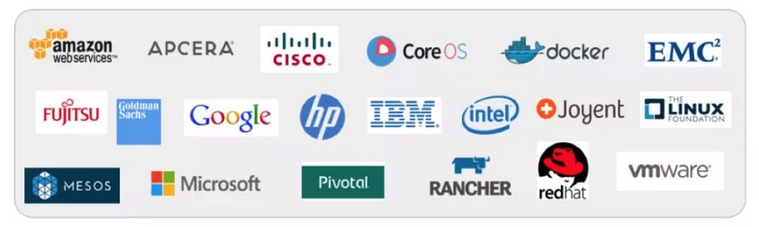
libcontainer and the Open Container Foundation
A standardised interface into the container layer
Part of runC the open runtime from Docker
A key basis of the Open Container Foundation

Slide 10

Cloud Native Computing Foundation
A new definition of “Cloud Native”
Container Packaged
Dynamically Managed
Micro-Service oriented

Slide 11
Docker on top of LXC
Docker adds several things to LXC and containerization:
Copy on write filesystem
Layered images and the ability to extend machines easily
Simple textual config file
Portable deployment across machines
Creating an ecosystem of images
Application centric
Each VM is a process (roughly speaking)
Plus others (auto-build, etc)

Slide 12
Why Docker?
The ecosystem has created a network effect
Metcalfe’s Law states
the value of a telecommunications network is proportional to the square of the number of connected users of the system
There is surely a corollary for ecosystems

Slide 13

How does Docker work?

Slide 14
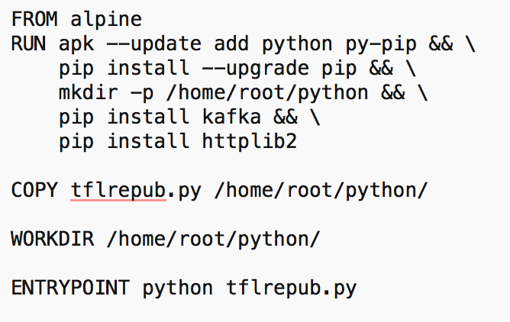
Dockerfile

Slide 15
Some simple Docker commands
apt-get install docker.io
docker pull ubuntu
docker run –t –i ubuntu /bin/bash
docker ps
docker commit funky_freo image
docker push image

Slide 16
Docker Compose
A way of configuring multiple Docker containers
Solves security issues
Shouldn’t put secrets in Dockerfile or Docker image
Manages dependencies between containers

Slide 17

docker-compose.yml

Slide 18
Docker Machine
Manages docker servers
e.g. VirtualBox, Amazon, DigitalOcean
Let’s you start/stop and configure Docker to talk to the remote server

Slide 19
Quick demo

Slide 20
Cloud Orchestration
What does an Operating System do?
Manages processes
Co-ordinates the processes access to resources
CPUs
Memory
Disk
Devices
Fairness and priority between processes

Slide 21
Datacenter Operating System aka Container Orchestration
Manages the placement of containers
Access to resources
Configuration and networking
Moves containers
Load balances across containers
Effectively creating a single OS across a cloud
Containers vs Processes

Slide 22
Docker Swarm
Manages clusters of Docker servers
Linking with Compose, Machine and Docker
Service Discovery
Load Balancing
Scaling
Declarative
i.e. I want 10 versions of this service

Slide 23
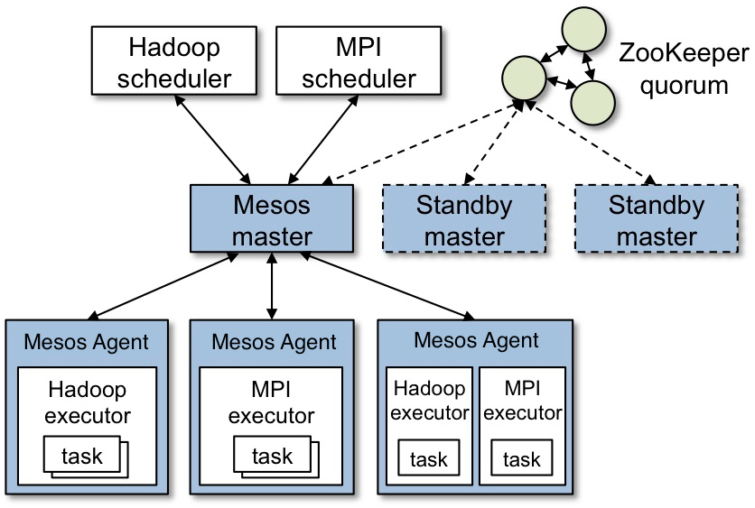
Apache Mesos

Slide 24
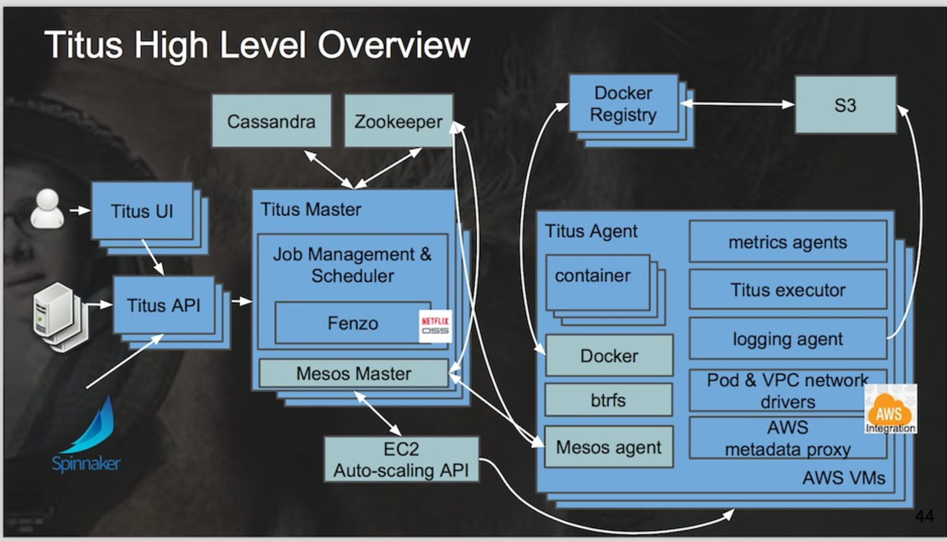
Netflix Titus
Running on 5000 AWS instances (m4.4xlarge and r3.8xlarge) Three regions
10,000 containers running at any time
1,000,000 containers launched
https://www.infoq.com/news/2017/07/netflix-titus

Slide 25

Kubernetes
Open Source cluster management of containers
From Google, but separate from the Borg project

Slide 26
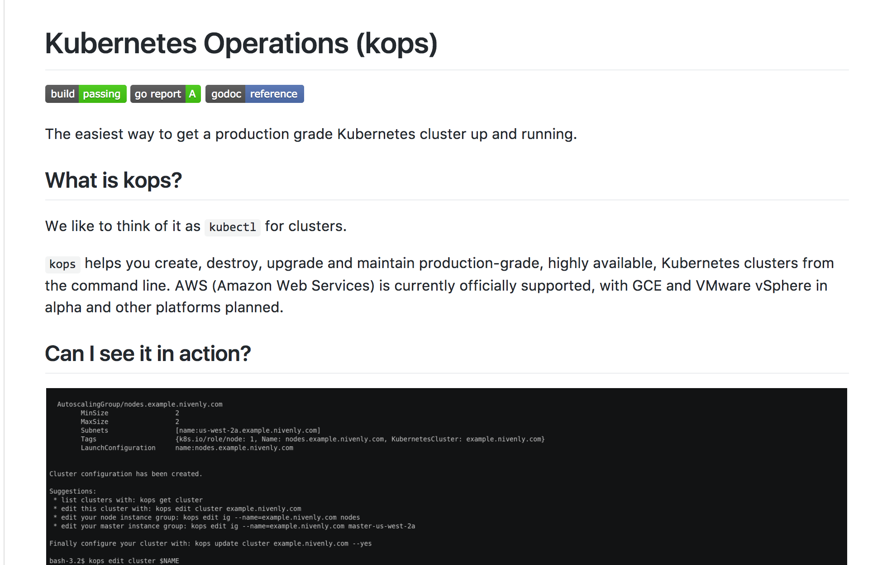
KOPS

Slide 27

DevOps

Slide 28
DevOps
DevOps is the codification of the interface between Development and Operations
Agile
Repeatable
Collaborative
Versioned
Automated

Slide 29
Cloud and DevOps
It could be argued strongly that the rise of DevOps is tied to the rise of Cloud
Clear requirement for automated, repeatable configuration and deployment
Reducing the hardware provisioning time has highlighted the challenges

Slide 30


Kittens vs Cattle (An unpleasant but effective analogy)

Slide 31

Blue Green Deployment
http://martinfowler.com/bliki/BlueGreenDeployment.html

Slide 32
DevOps tools
Puppet, Chef
Automated configuration and deployment tools
Allow complex infrastructures to be re-configured automatically
Vagrant
Create VMs instantly
Plus many many more!

Slide 33
DevOps and Docker
Docker is a key DevOps tool
Speeds up the creation of repeatable deployments
Consistency between development, test and production
Versioned repository
Works with Chef, Puppet, etc

Slide 34
Challenges with Docker and Solutions
Networking
It is very complex to connect different containers, even on a single machine
Weave Networks
SocketPlane (bought by Docker)
Clustering
Docker Swarm
Google Kubernetes
CoreOS
Apache Mesos
Lack of mutable file system
Flocker

Slide 35
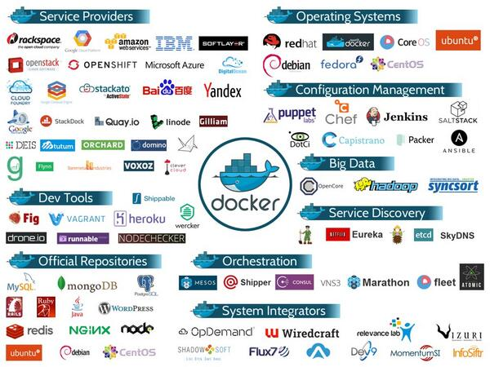
Docker ecosystem

Slide 36
Summary
Docker and the Container model
Lightweight virtualization and repeatability
Blue Green deployment
“Warehouse Scale” computing

